Slide 1
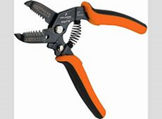
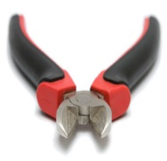
Ordinary hand tools
1. Wire stripper
- It is used for stripping and cutting of wires.
2.Side cutter
- It is used for cutting and stripping of wires.

Slide 2
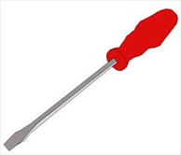
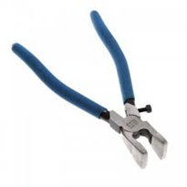
3. Screwdrivers
- It is used for loosening and tightening of screws.
4. Pliers
- It is used for cutting of wires.

Slide 3
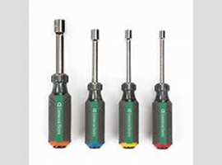

5. Nut drivers.
- It is used for loosening and tightening of nuts.
6. Hacksaw
- It is used cutting of pvc pipes and cables.

Slide 4

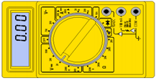
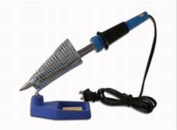
7. Fishing tool
- It is used for building walls.
Power tools
1. Meter tester
- It is used for checking the flow of current on the wires.
2. Soldering
- It is used for joining of wires.

Slide 5


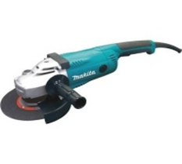
3. Cordless hand drill
- It is used for loosening and tightening of screws and nuts.
4. Power hand drill
- It is used for loosening and tightening of screws and nuts.
5. Angle grinder
- It is used for grinding walls.

Slide 6
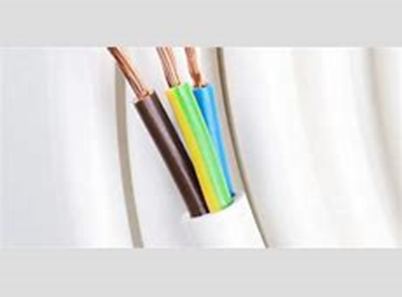
Colour coding of a 3 – core cord
Coding
1. Live – Red or brown colour
2. Neutral – Black or blue colour
3. Earth – Yellow & green colour or copper wire
Video : https://youtu.be/OIO3hKyN7ko?si=88_WhHgYBoI-SOXm
Feedback : Activity

Slide 7

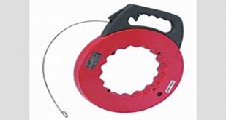

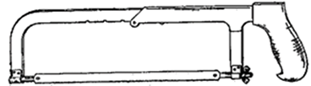
Kwa Thema Skills School
Subject : Maintenance Marks: 10
Grade : Year 1 Time : 30mins
Date : / / 2024
Question : 1
1.Identify the following hand and power tools.
1.____________________ 2.______________________
3.____________________ 4.______________________

Slide 8



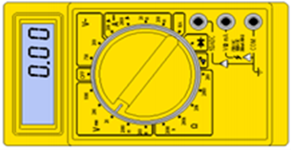


5.___________________ 6. ______________________
7. ___________________ 8. ______________________
9. ______________________ 10. ______________________

Slide 9
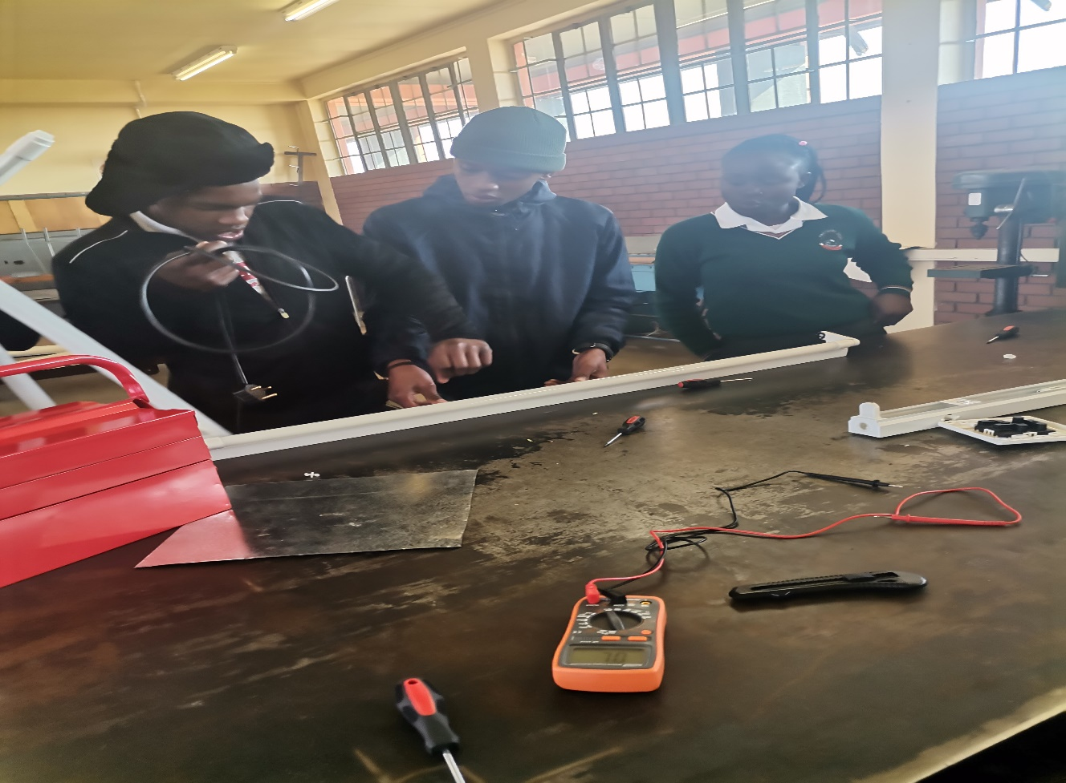
Feedback : Activity
(Practical Lesson or Project)
Connect a Florescent Light

